Slide 1
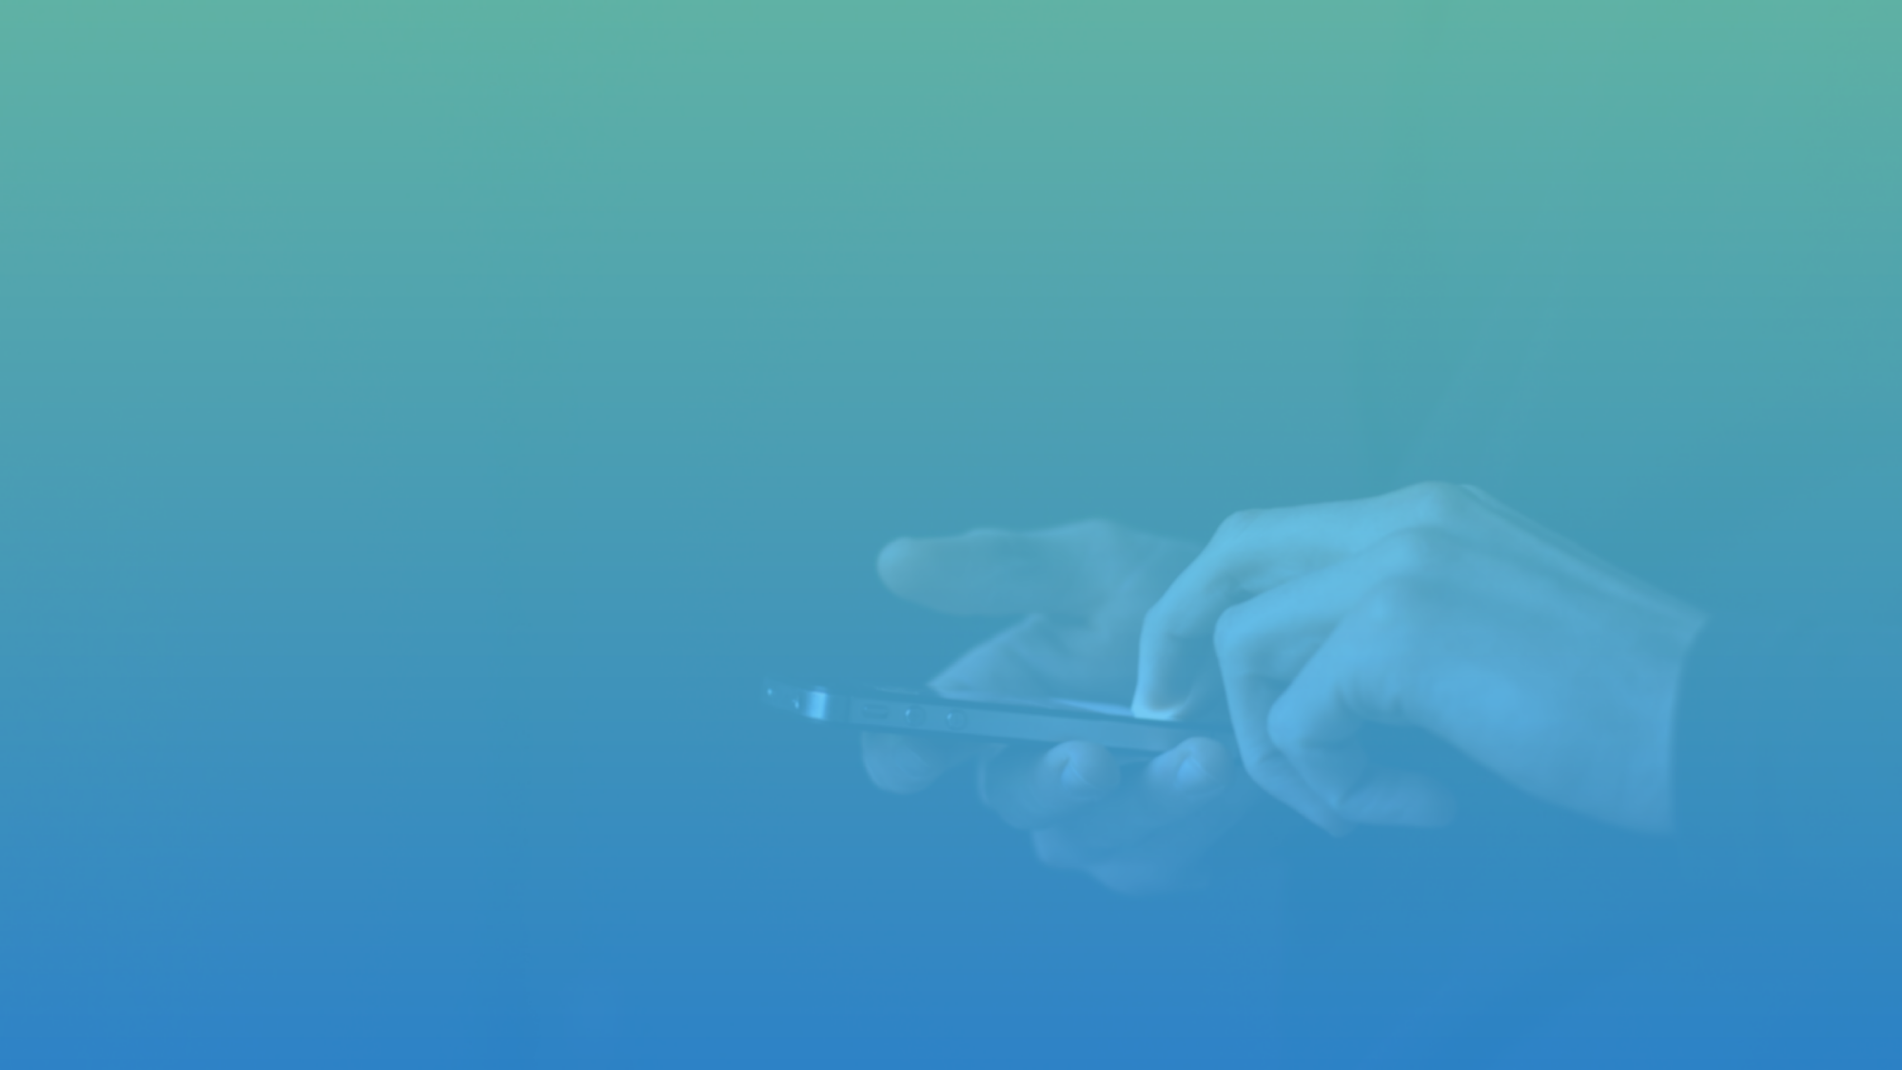

Health Services Improvements
A solution for better health
Lifement

Slide 2
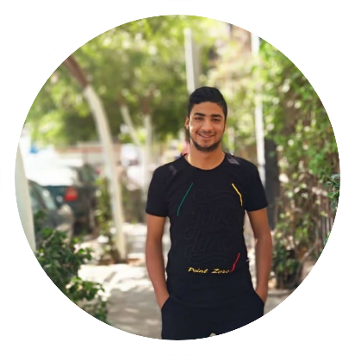
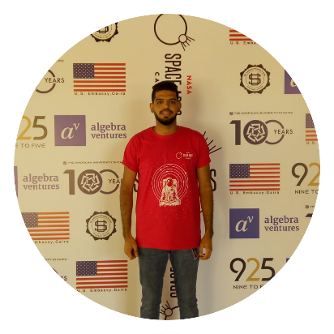
Team Members
Ahmed Mohammed Abdelaziz
Ahmed Hassan Abdelaziz
Lifement

Slide 3
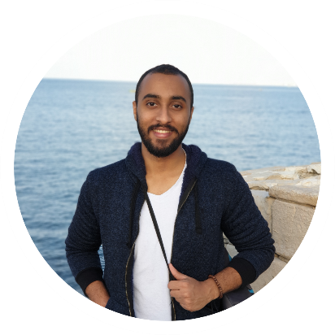
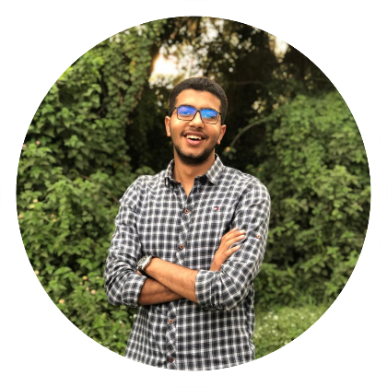
Team Members
Mahmoud Khairy Hosny
Khaled Mohamed Rabea El-hashash
Lifement

Slide 4
Faculty of Computers and Artificial Intelligence
Benha University
Lifement

Slide 5
01
Egypt tends to digitalize all of its departments by 2030.
Intro
Health field has a lot of problems in Egypt that need to be solved.
Lack of health awareness in the Egyptian citizen that leads to a lot of health issues.
The fast development in mobile technologies is the main key to a better future.
Lifement

Slide 6

02
As we get older our brains get weaker, so we forget a lot of important things like medicines time and reservations at hospitals, so we lose the ability to take care of our health.
Problem
Talking to others to find the best place to do a surgery or to get some information about any hospital can waste a lot of time and not very efficient.
Lifement

Slide 7
02
Our children’s health may be in danger if we forget to give them scheduled vaccines in the right time
Problem
Accidents can happen to anyone in anytime, and there is no right way to protect ourselves from getting lost or from getting wrong medicine at emergency situations.
Lifement

Slide 8

03
Having a Busy life? Getting older? Don’t worry about forgetting your medicines, or reservations time we will remind you with it.
Goal
Need to do a surgery and don’t know where to go? We will provide you with places near by you that do this surgery with details.
Lifement

Slide 9
03
We will remind you with every vaccine that is important for your child health at the right time, so don’t worry to miss anything again
Goal
Want to be able to reach your family and your friends if an accident happen? We will enable you to send them your location.
Lifement

Slide 10

04
With mobile application we will make the user able to:
Solution
Adding remainders to his medicines or reservations so he don’t miss anything important for his health.
Search for any surgery, rays or department in any hospital nearby him by using his location, and this will save a lot of time and effort for him.
Lifement

Slide 11
04
With mobile application we will make the user able to:
Solution
Add their children to be able to track their vaccines progress and find some useful information about each vaccine.
Show a notification in emergencies that contains some medical information about him, and contact his family and his friends.
Lifement

Slide 12
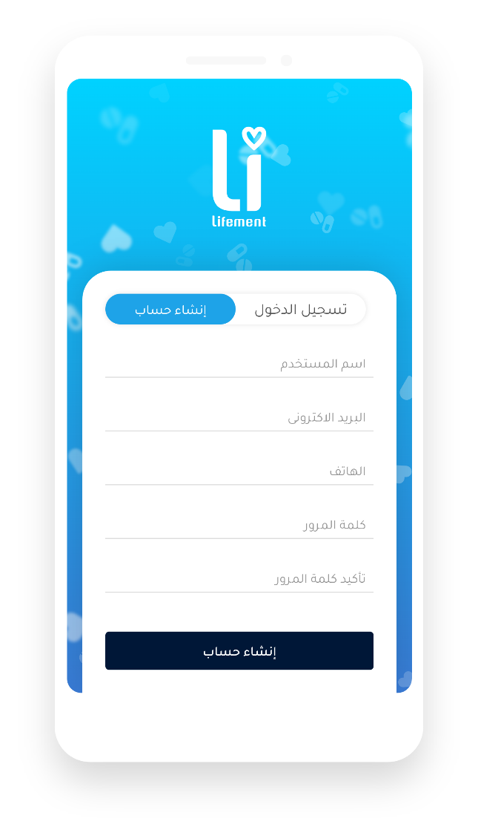
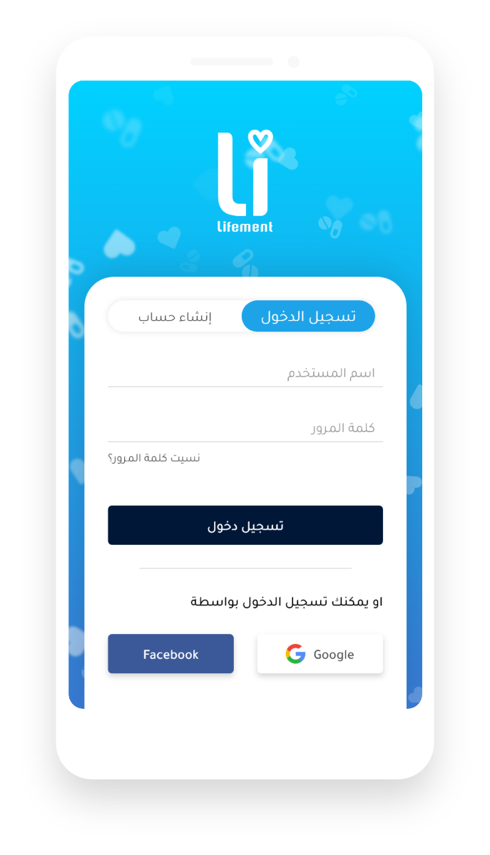

05
Design
Login - Register
Lifement

Slide 13
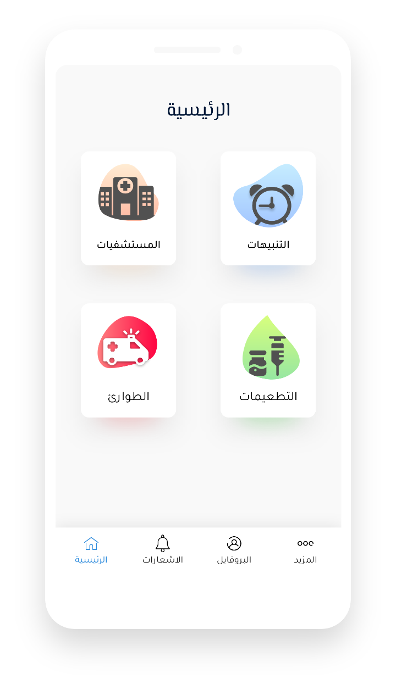
05
Design
Home
Lifement

Slide 14
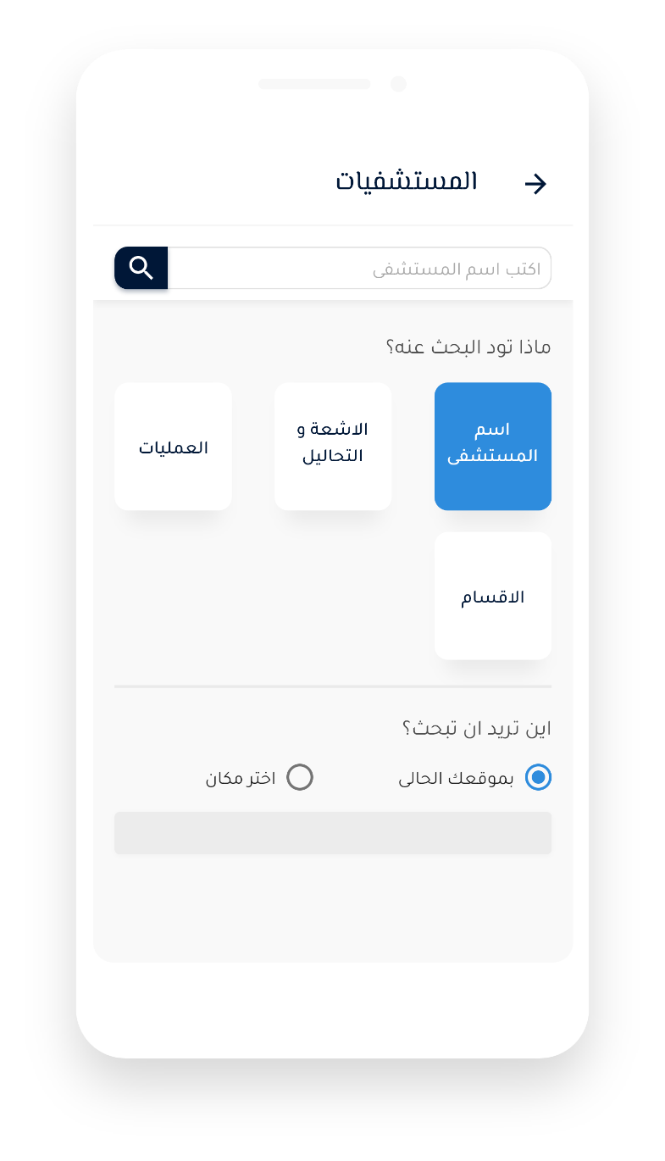
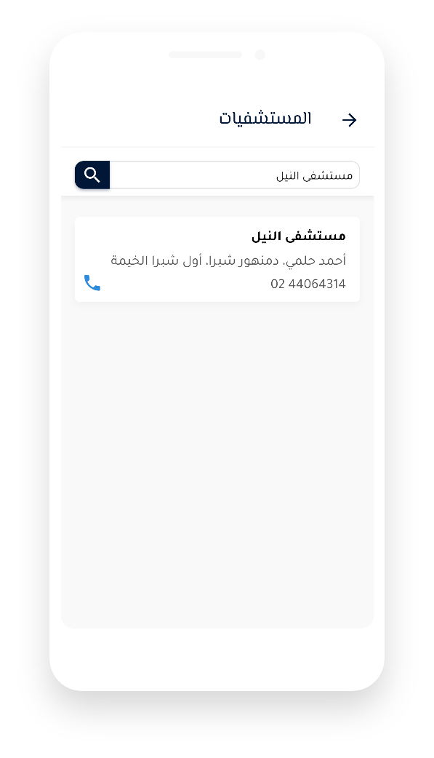
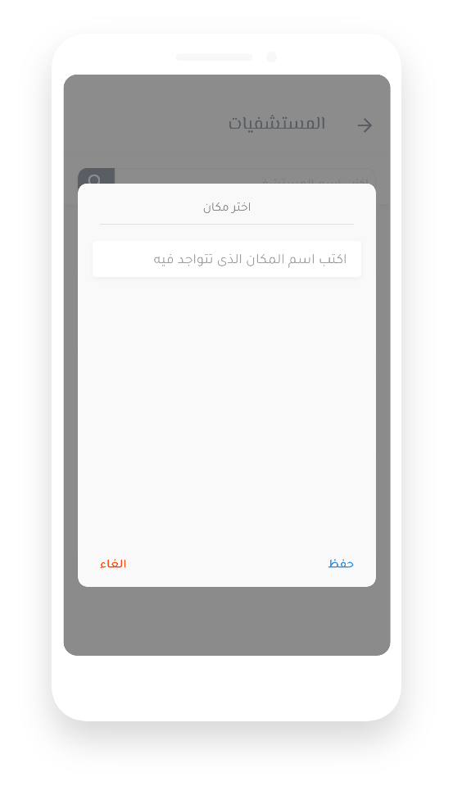
05
Design
Hospitals
Lifement

Slide 15
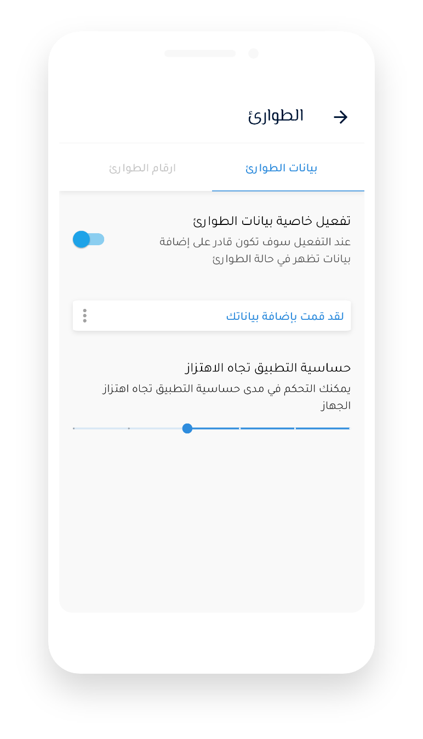
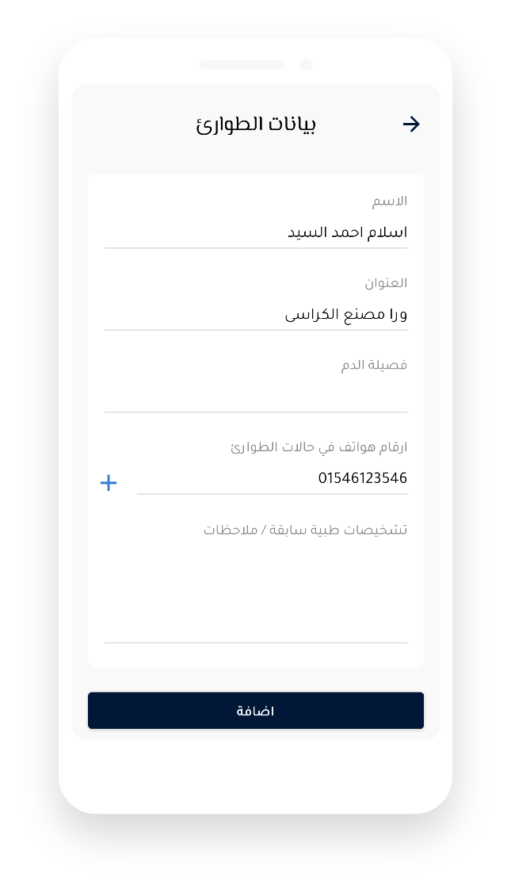
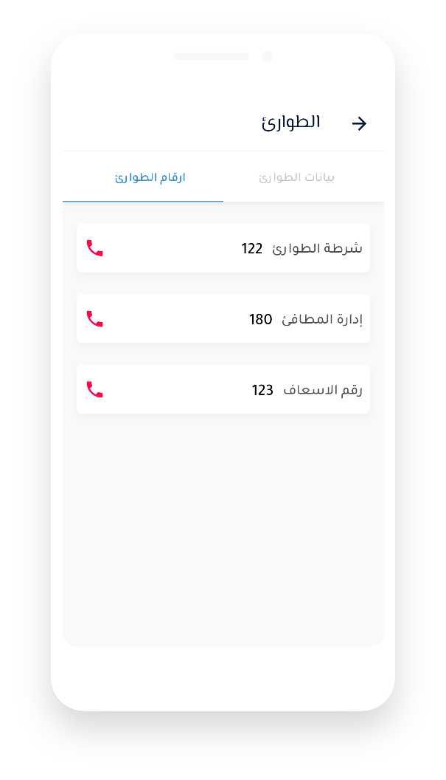
05
Design
Emergency
Lifement

Slide 16
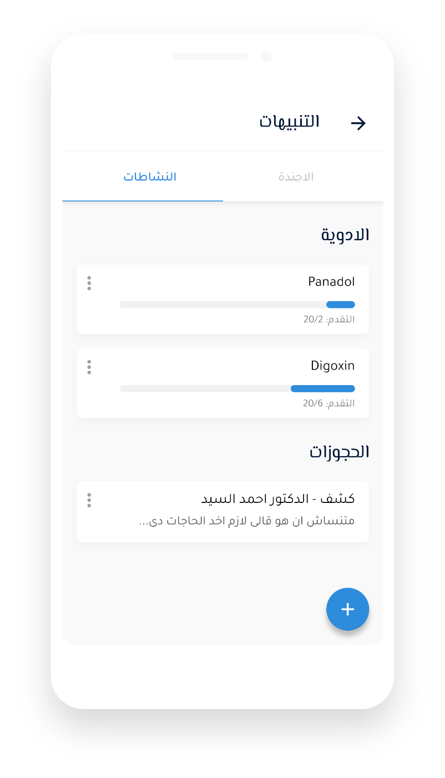
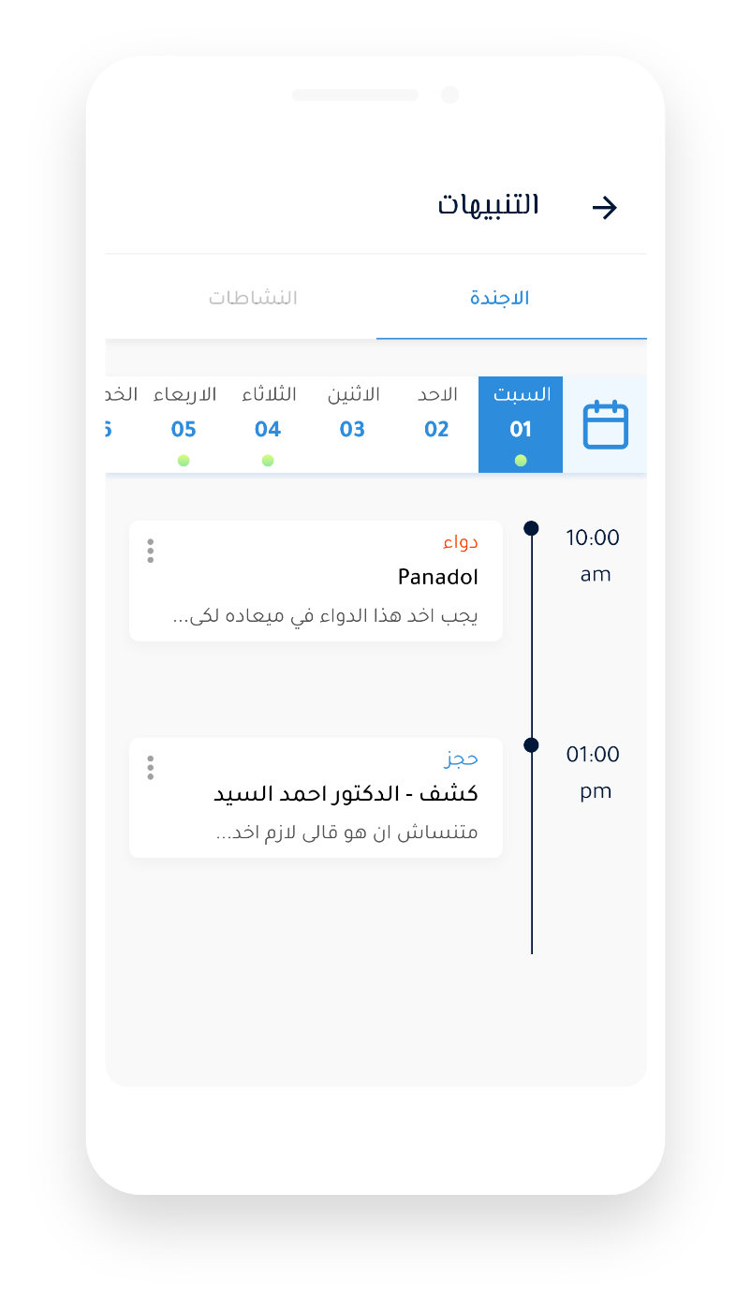
05
Design
Alarms
Lifement

Slide 17
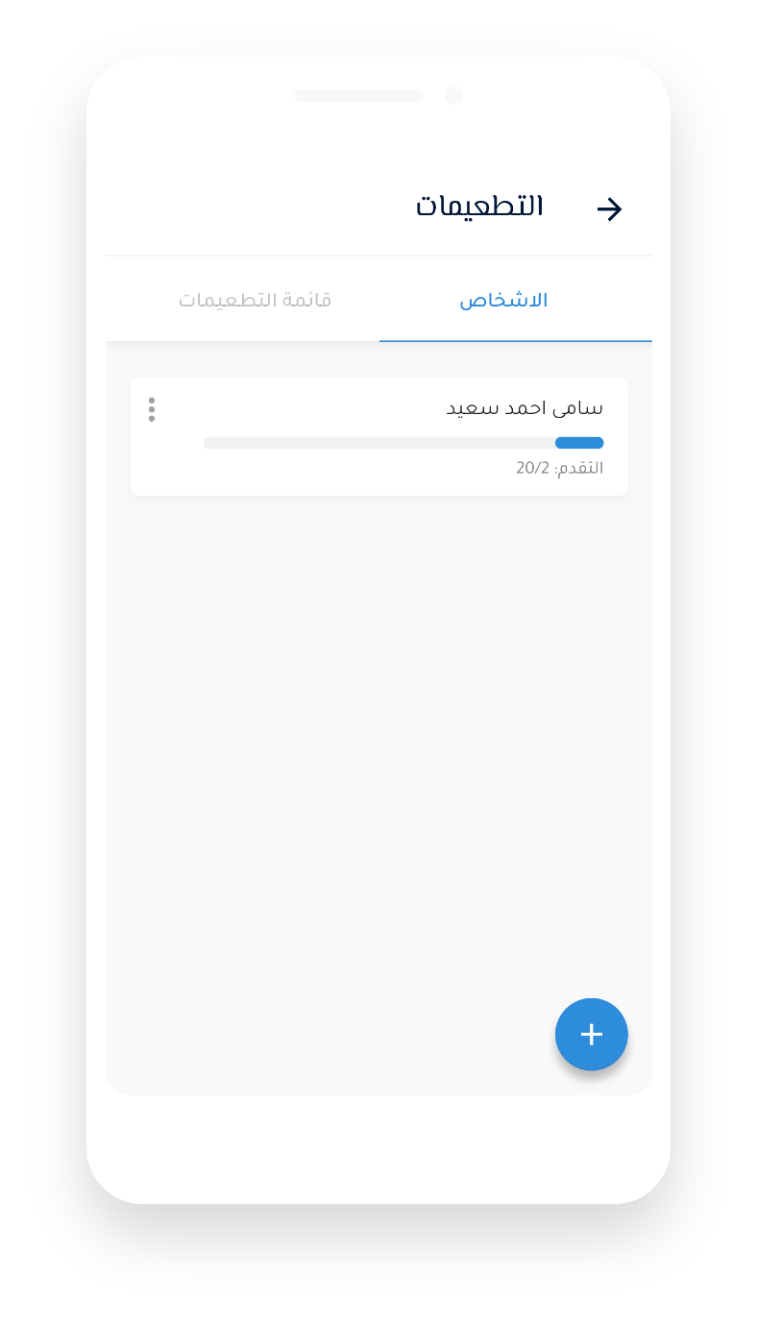
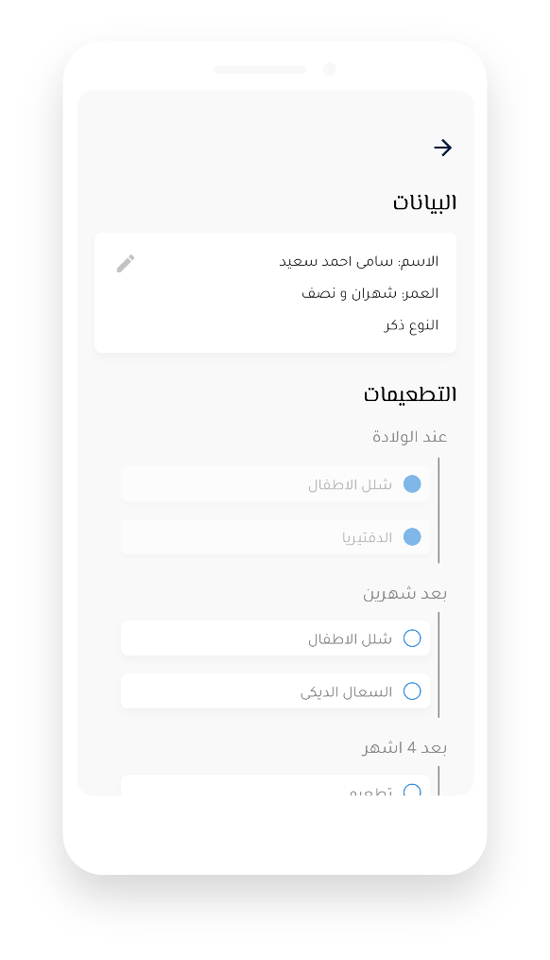
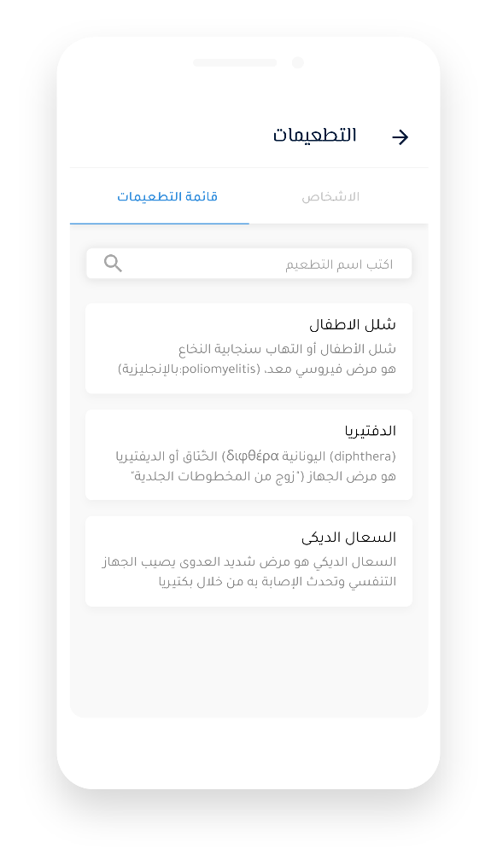
05
Design
Vaccines
Lifement

Slide 18
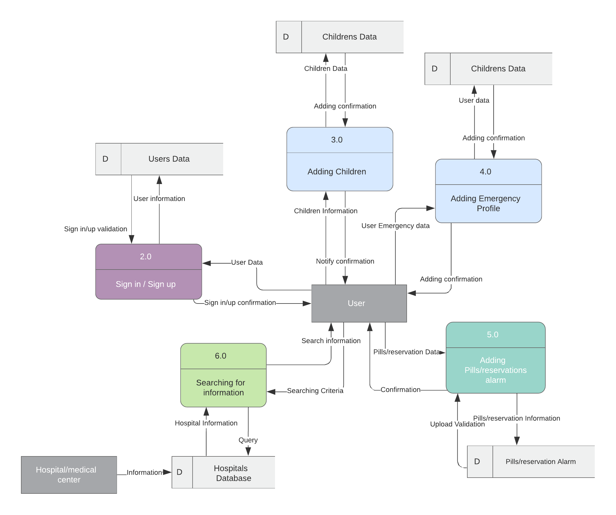
06
DFD
Lifement

Slide 19
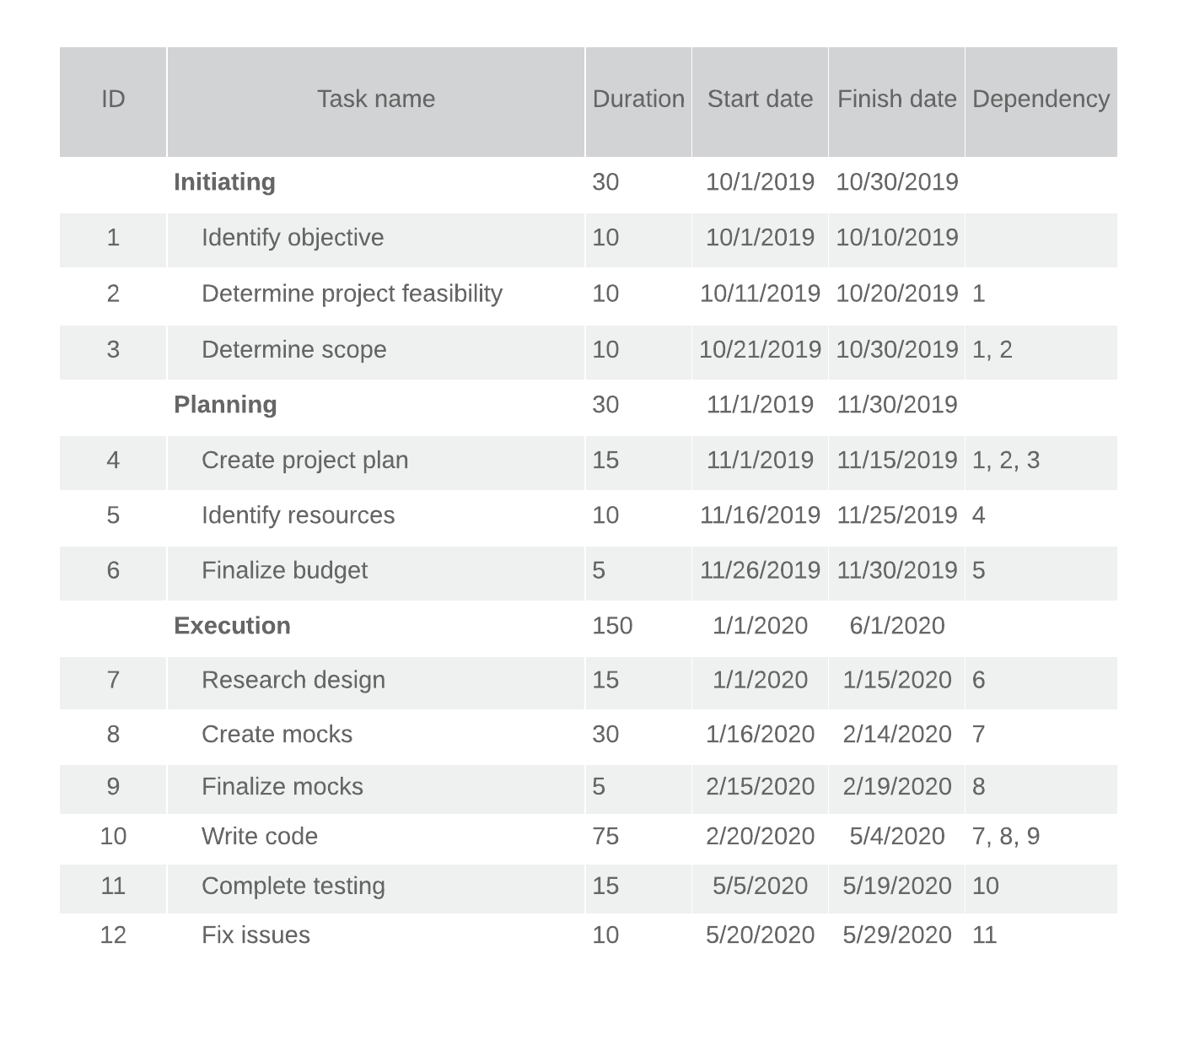
Thank you
Lifement

Slide 20







08
Conclusion

